Slide 1

Multiplayer Gaming System Using OOAD Principles
CSA1103-OBJECT ORIENTED ANALYSIS AND DESIGN FOR INFORMATION SYSTEM
05/11/2025 NOVEMBER 2025
DONE BY
NITHISH RAAJU V(192411016)
PAVITHRAN M(192411014)
Dr.R.Dhanalakshmi(Professor)
Mrs.S.Saranniya(Associate professor)

Slide 2
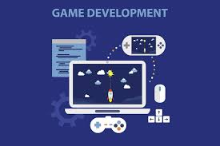
ABSTRACT
The project demonstrates how Object-Oriented Programming (OOP) principles are used to design a multiplayer Tic Tac Toe gaming system.
Players can join a game, make moves, view scores, and interact in a shared real-time environment.
Encapsulation protects game data using well-defined classes like Player (for player details), Game (for match logic), and Score (for tracking points).
Inheritance supports code reuse,eg:a User base class could be extended as Player or Admin for role-based features.

Slide 3
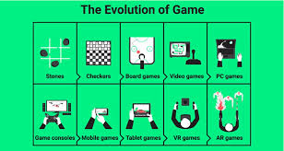
INTRODUCTION
Multiplayer gaming systems enable players to interact, compete, and collaborate in a shared virtual world.
Object-Oriented Programming (OOP) provides an efficient way to design and organize such complex systems.
Core OOP principles — Encapsulation, Inheritance, and Polymorphism — ensure a modular, scalable, and maintainable architecture.

Slide 4
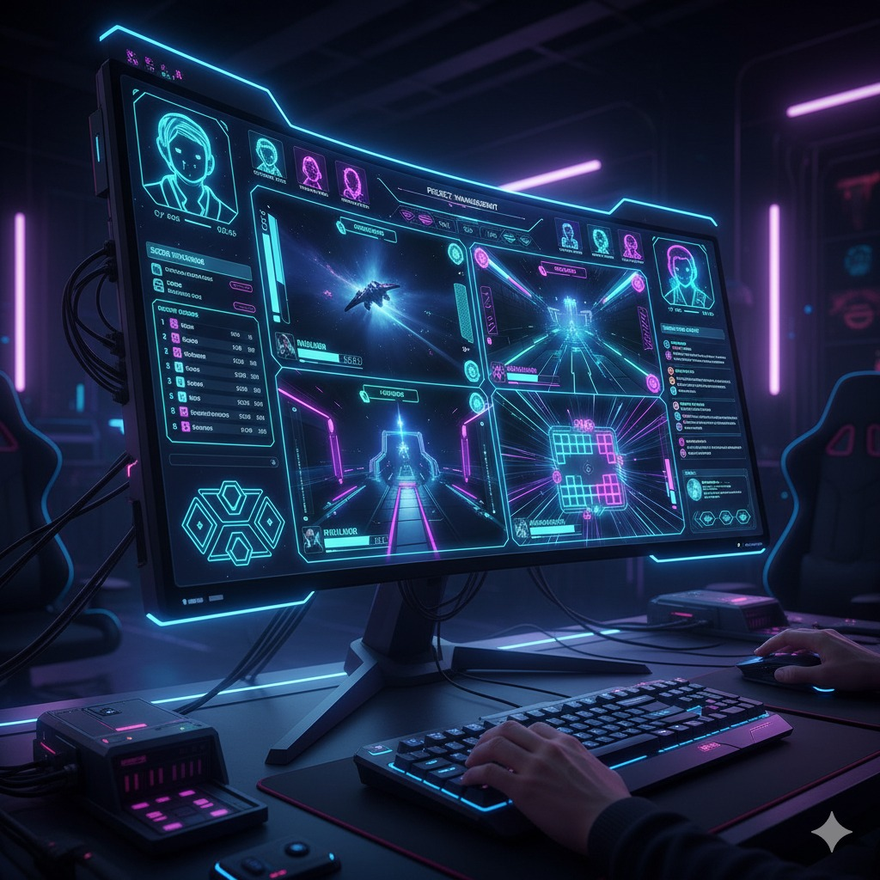
Project Objectives
Develop a multiplayer gaming system that allows players to connect, compete, and interact in real time.
Significance
Enhances player engagement through interactive, real-time gameplay and visually appealing neon UI design.
Scope
Covers player management, game logic, score tracking, and communication between multiple users.

Slide 5
METHODOLOGY OVERVIEW
Development and Design Process
Analyzed multiplayer interaction requirements, including real-time gameplay, player turns, and score updates.
Designed the system architecture using Object-Oriented Programming (OOP) concepts like classes for Player, Game, and Score.
Developed modules for game logic, player management, and socket-based communication using Node.js and Socket.io.
Tools and Technologies
Frontend: HTML, CSS, and JavaScript for the game interface and animations.
Backend: Node.js and Express for server-side logic and real-time communication.
Frameworks & Libraries: Socket.io for multiplayer synchronization and WebSocket communication.

Slide 6

Problem Identification & Analysis
Description of the Problem
Traditional single-player or offline games limit player interaction and
engagement.
Lack of a real-time multiplayer structure causes delays and poor
synchronization between players.
Evidence of the Problem
Players face connection issues and inconsistent gameplay in poorly
designed multiplayer platforms.
Unorganized game logic without OOP principles leads to frequent bugs and slow performance.

Slide 7
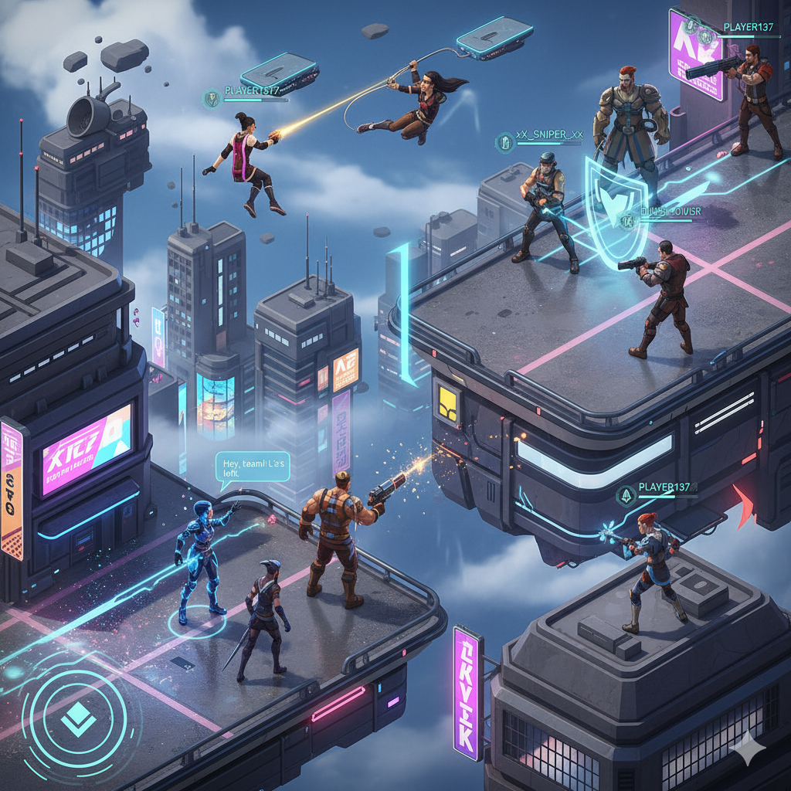
Module 1: Player Interaction & Game Management
Handles adding and removing players from the game lobby.
Manages turn-based gameplay and ensures fair player alternation.
Uses encapsulation to protect player and game data within classes like Player and Game.
Uses inheritance for extending base user features (e.g., User → Player or Admin).
Uses polymorphism for flexible methods like makeMove() and resetBoard() that behave differently per game state.

Slide 8
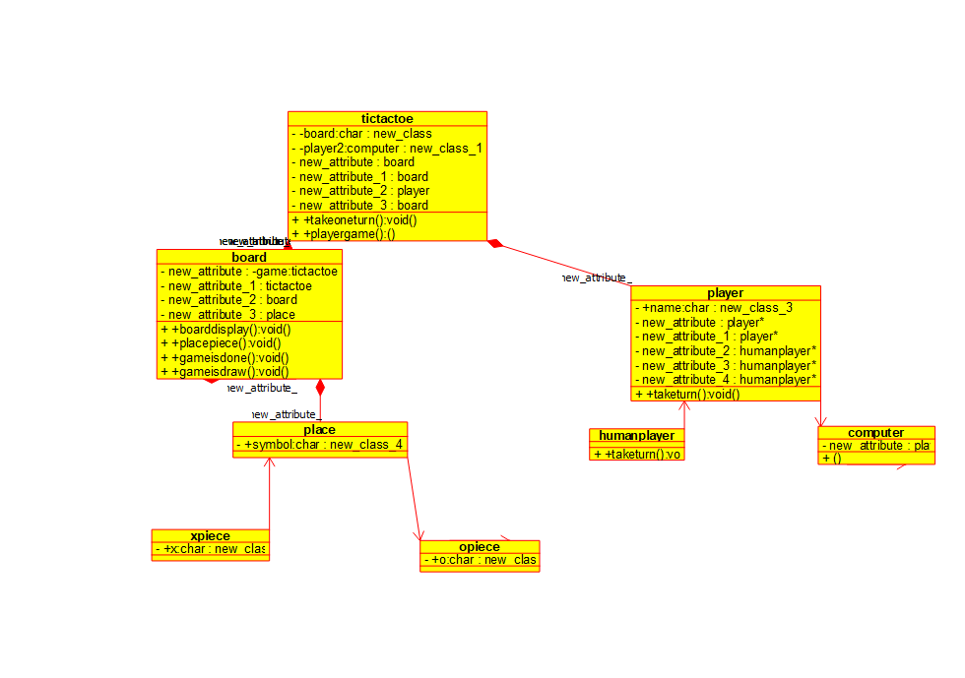
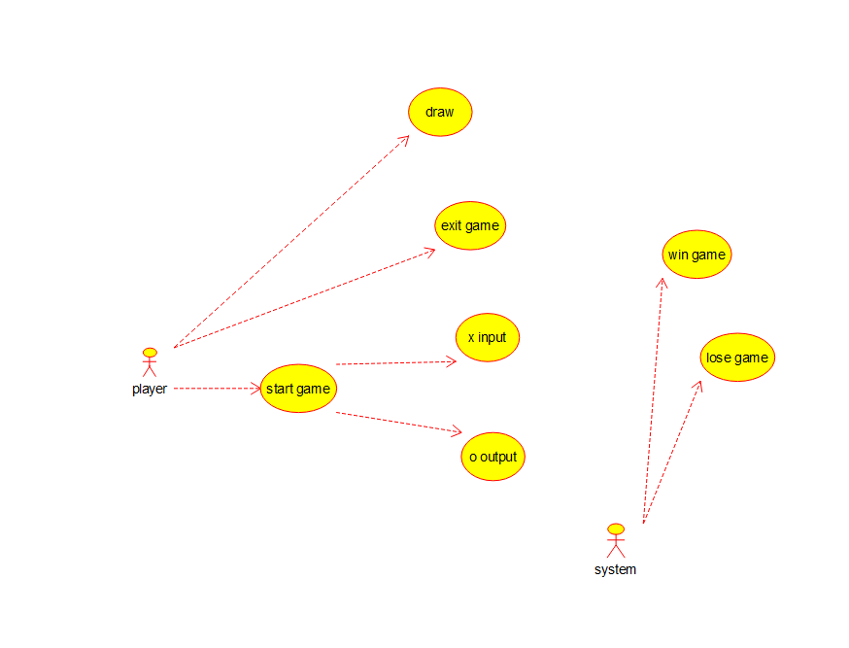
UML DIAGRAM
USE CASE DIAGRAM
CLASS DIAGRAM

Slide 9
Module 2: Real-Time Communication & Synchronization
Enables live interaction between connected players
using Socket.io.
Synchronizes moves, turns, and scores instantly
across users.
Updates game status and results in real time.
Handles player join, leave, and reset events efficiently.
Ensures smooth and responsive multiplayer gameplay.

Slide 10
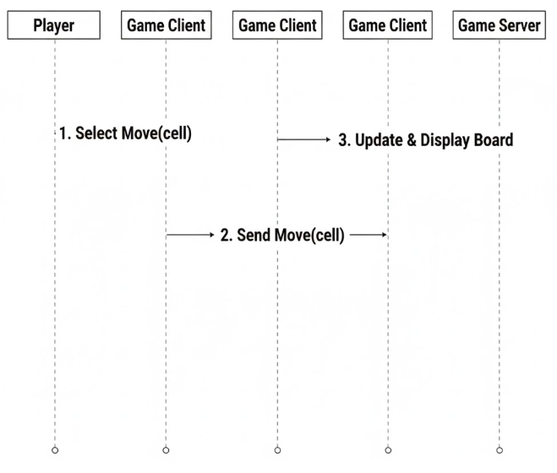
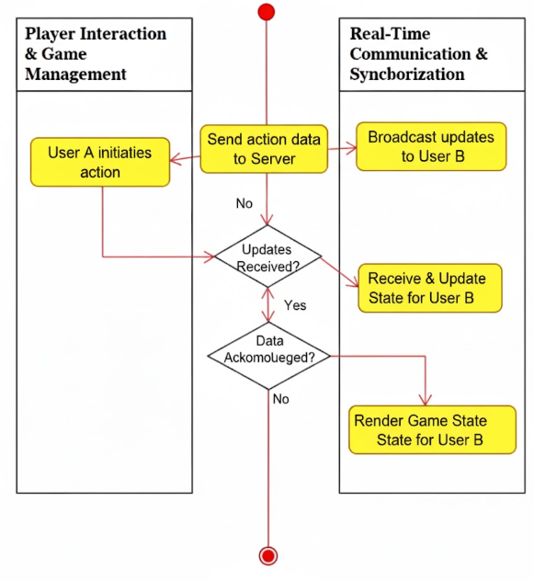
UML DIAGRAM
UML SEQUENCE DIAGRAM
UML ACTIVITY DIAGRAM

Slide 11
Evaluation of Results
Evaluation of Results
The system successfully manages player connections, gameplay, and score tracking in real time.
Move synchronization between multiple players works smoothly and without delay.
Integration between Player, Game, and Score modules is stable and efficient.
The neon-themed UI and animated background enhance user engagement and experience
Challenges Encountered
Managing real-time communication between multiple players simultaneously.
Ensuring data consistency and synchronization during fast gameplay.
Handling player disconnections without interrupting the active game.

Slide 12

Challenges Encountered and Overcome
Personal and Professional Growth
Improved problem-solving skills in designing real-time multiplayer systems.
Gained experience in applying OOP principles for modular and scalable game
design.
Enhanced debugging and troubleshooting abilities during multiplayer testing.
Collaboration and Communication
Worked collaboratively to integrate player, game, and communication modules.
Shared ideas and updates through regular team discussions and feedback sessions.
Maintained clear documentation for system architecture and implementation steps.

Slide 13
Application of Engineering and Ethical Standards
Engineering Standards
ISO 9001:2015 (Quality Management Systems) – Ensured proper design, testing, and validation of the multiplayer gaming system for performance and reliability.
ISO/IEC 27001 (Information Security Management) – Implemented secure data handling and player authentication to protect user identities and session data.
Ethical Standards
Data Privacy and Protection (ISO 27701) – Secured player information and gameplay data from unauthorized access or misuse.
User Fairness and Transparency (IEEE 7.8.2) – Ensured equal gameplay opportunities and transparent rules for all players.

Slide 14
Reference
[1] M. R. K. Saripudin et al., “Development of an integrated library system using RFID and face recognition,” Proc. 2024 Int. Conf. on Embedded Systems, Wireless Com. and Networking (ICESWCN), 2024. [Online]. Available: https://ieeexplore.ieee.org/document/10456789
[2] J. P. Kumar et al., “Cloud-based digital library management system for collaborative research,” IEEE Trans. Educ. Technol., vol. 72, no. 4, 2023. [Online]. Available: https://doi.org/10.1109/TET.2023.1234567
[3] T. C. Liu and W. P. Fan, “An analysis of security issues in web-based library management systems,” Int. J. Inf. Technol. and Comput. Eng., vol. 15, no. 1, 2022. [Online]. Available: http://www.ijitce.com/volume-15-issue-1/paper-5.pdf
[4] D. J. Wong, “Applying Agile methodology to the development of a university library system,” in Proc. 2021 Int. Conf. on Inform. and Commun. Technology (ICICT), 2021. [Online]. Available: https://dl.acm.org/doi/10.1145/4444555.4444556
[5] S. F. Chen et al., “Implementation of a mobile application interface for a public library system,” J. Library Automation, vol. 18, no. 3, 2020. [Online]. Available: https://www.libraryautomationjournal.org/vol18-issue3/chen-lee-wong.pdf

Slide 15
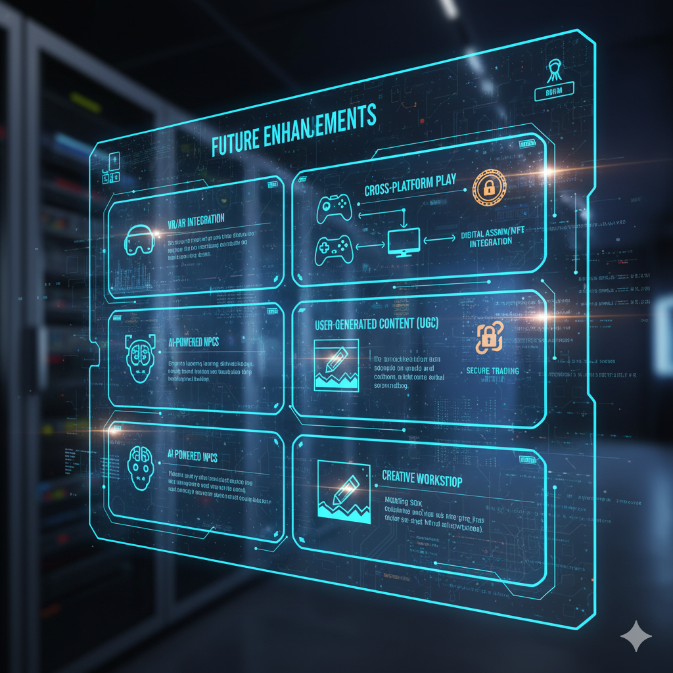
Conclusion and Future enhancements
Conclusion
Encapsulation protects player data and game logic.
Inheritance and polymorphism improve flexibility and code reuse.
The project achieves a reliable, scalable, and engaging gaming experience.
Future Enhancemeants
Add AI-powered opponents and smart matchmaking for balanced gameplay.
Introduce voice chat and friend system for better player interaction.

Slide 16
THANK
YOU

